Slide 1

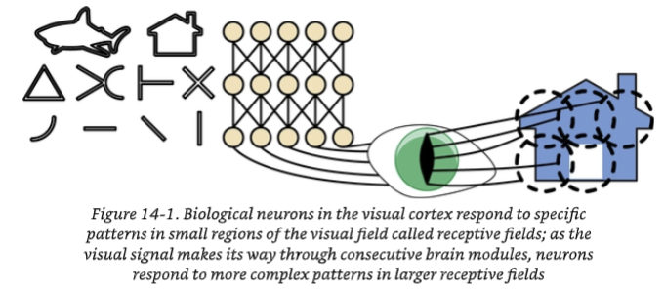

CSC485B Machine Learning for Robotics
SUNY Plattsburgh
Dr. Ned Lecky
Class 23: Deep Computer Vision

Slide 2
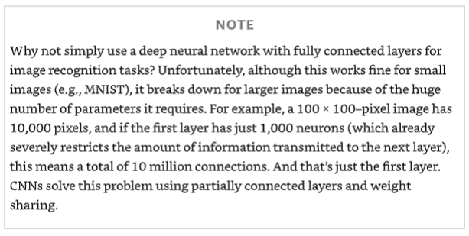
CNNs
Vision has a HUGE input space
Treating all the pixels as independent inputs swamps you with data
Some sort of feature extraction needs to happen first!
Today we’ll explore with Sherlock and AuroraVision

Slide 3
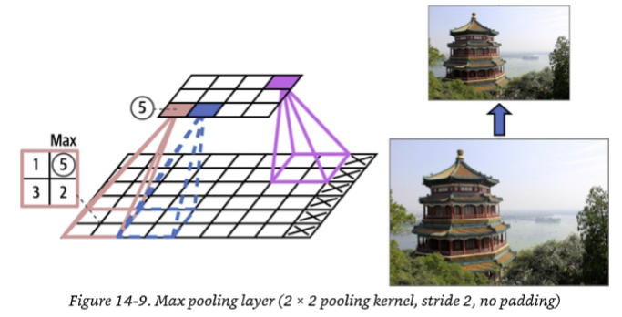
Pooling Layers
Subsampling! Throwing away resolution!
Critical to getting decent performance

Slide 4
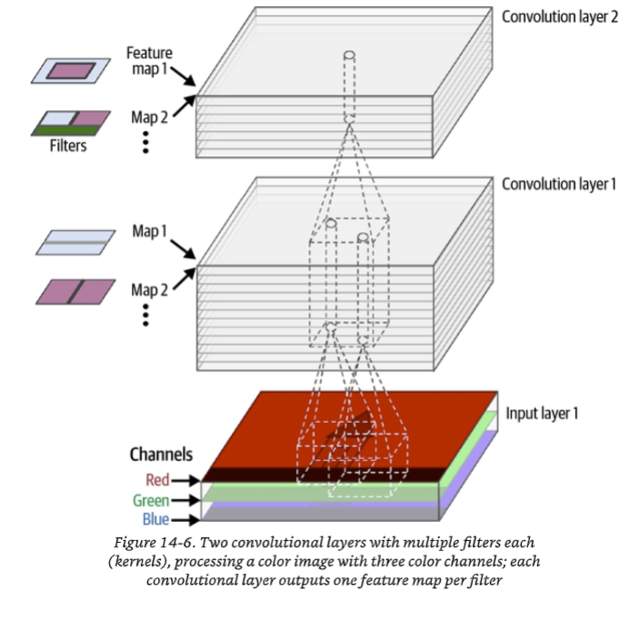
Convolutional Layers
Two flavors… hand crafted and automatic
Imagine we take a 2D image and then
Create N 2D images (or sets of “features”

Slide 5
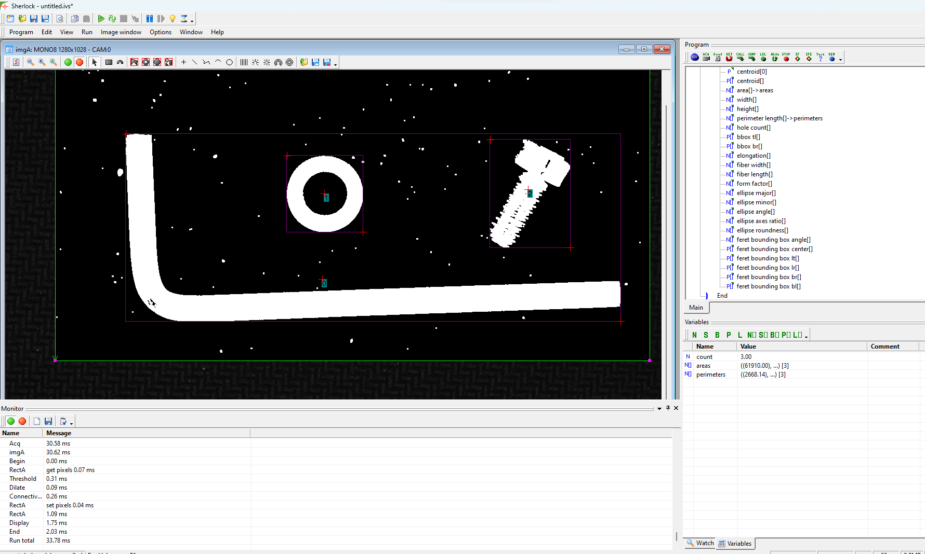
Designing Our Features
We can use our knowledge of the problem!

Slide 6
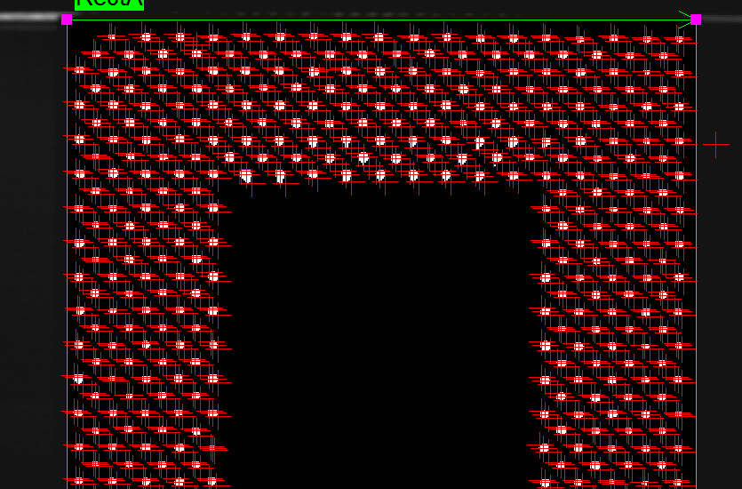
Counting Things
Reduce and apply!

Slide 7
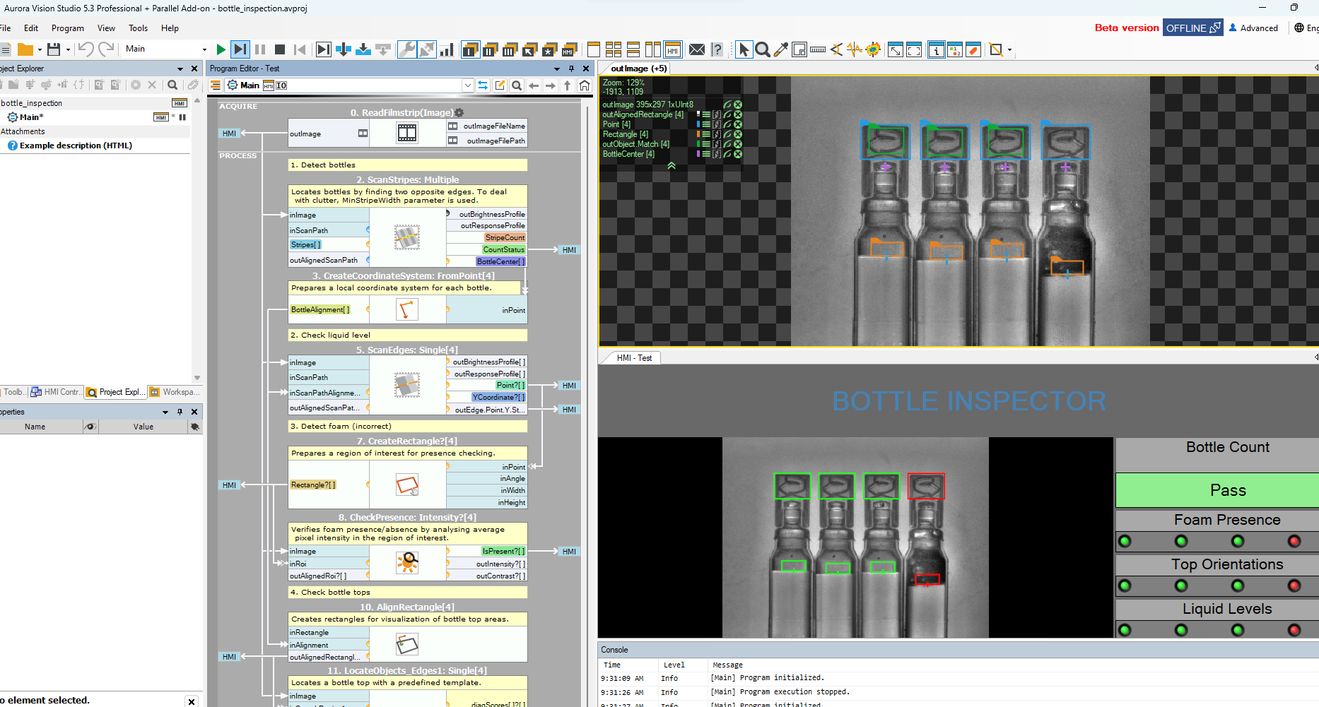
More Complex- Bottle Inspection
Lots to unpack here!

Slide 8
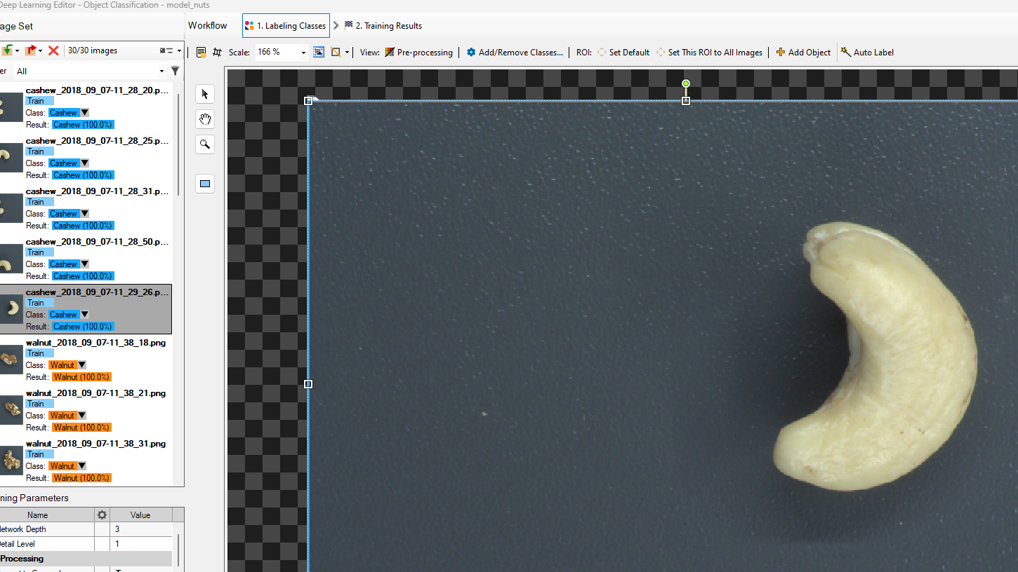
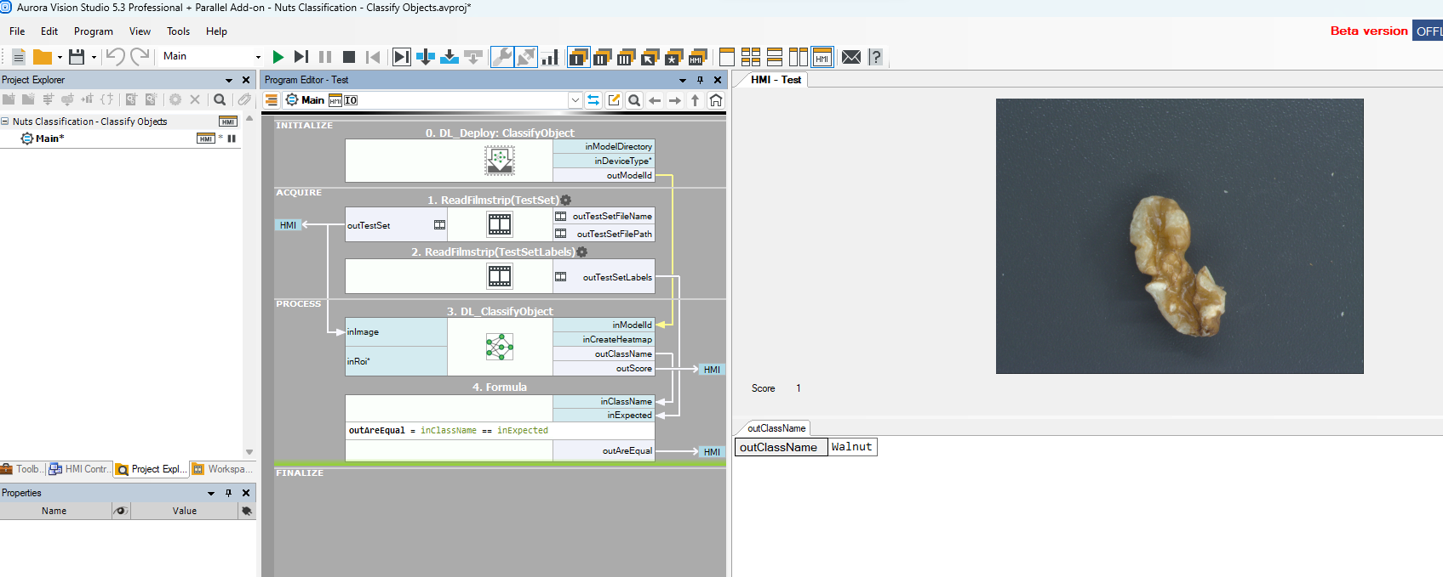
Too Complicated By Hand!
AuroraVision Deep Learning Example

